Slide 1

David M. Kroenke and David J. Auer Database Processing: Fundamentals, Design, and Implementation
Chapter Two:
Introduction to Structured Query Language
Part 2: Multiple Table Queries

Slide 2
Chapter Objectives
To understand the use of extracted data sets in business intelligence (BI) systems
To understand the use of ad-hoc queries in business intelligence (BI) systems
To understand the history and significance of Structured Query Language (SQL)
To understand the SQL SELECT/FROM/WHERE framework as the basis for database queries
To create SQL queries to retrieve data from a single table

Slide 3
Chapter Objectives
To create SQL queries that use the SQL SELECT, FROM, WHERE, ORDER BY, GROUP BY, and HAVING clauses
To create SQL queries that use the SQL DISTINCT, TOP, and TOP PERCENT keywords
To create SQL queries that use the SQL comparison operators including BETWEEN, LIKE, IN, and IS NULL
To create SQL queries that use the SQL logical operators including AND, OR, and NOT

Slide 4
Chapter Objectives
To create SQL queries that use the SQL built-in functions of SUM, COUNT, MIN, MAX, and AVG with and without the use of a GROUP BY clause
To create SQL queries that retrieve data from a single table but restrict the data based upon data in another table (subquery)
To create SQL queries that retrieve data from multiple tables using the SQL join and JOIN ON operations
To create SQL queries that retrieve data from multiple tables using the SQL OUTER JOIN operation

Slide 5
Chapter Objectives
To create SQL queries that retrieve data from multiple tables using SQL set operators UNION, INTERSECT, and EXCEPT

Slide 6
Coverage
This Microsoft PowerPoint Slide Show covers multiple table queries and the last four chapter objectives
The material in the Microsoft PowerPoint Slide Show for Chapter Two Part One on single table queries must by covered before discussing the material in this Slide Show.
A review of the Cape Codd Outdoor Sports database is included for continuity.

Slide 7
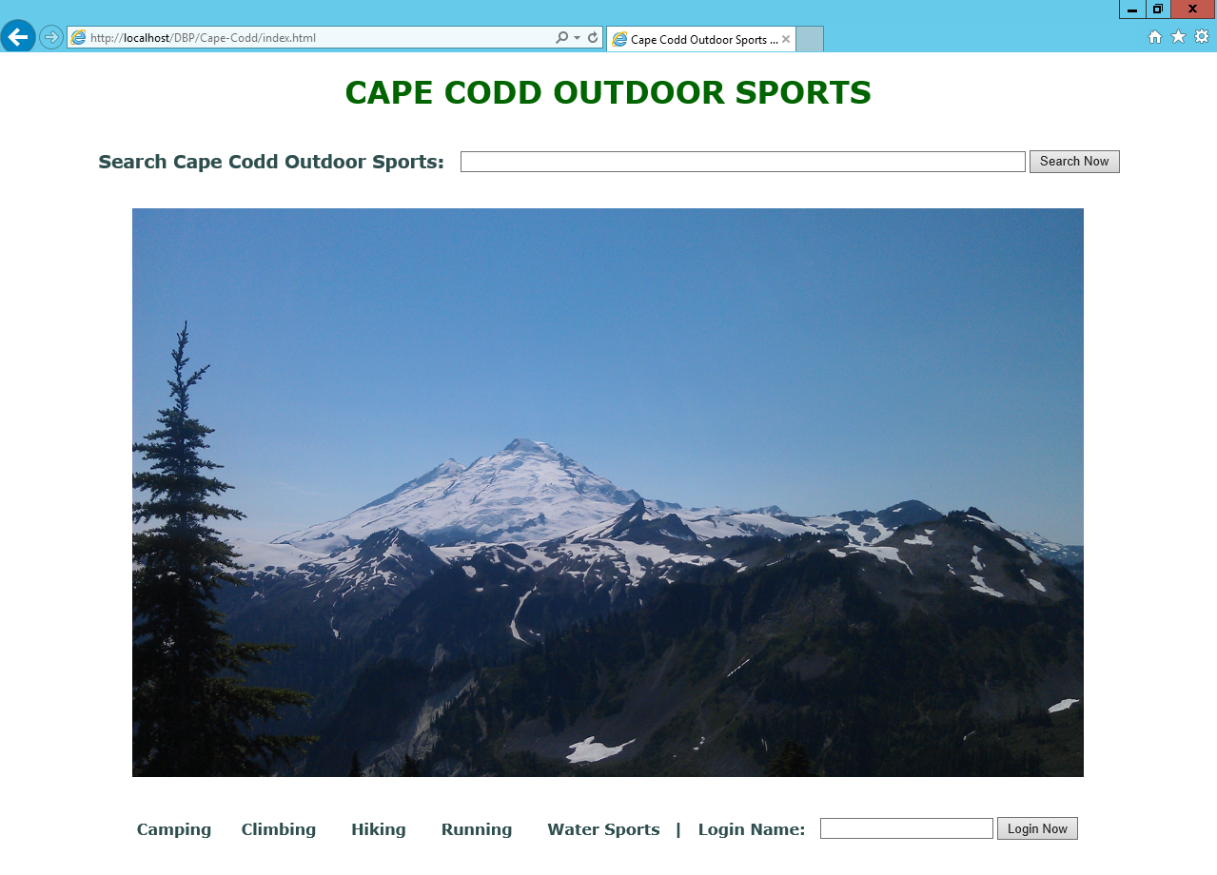
Cape Codd Outdoor Sports
Notes:
For our work in this chapter, we will use data from Cape Codd Outdoor Sports (although based on a real outdoor retail equipment vendor, Cape Codd Outdoor Sports is a fictitious company). The Cape Codd Outdoor Sports Web site is shown here.

Slide 8
Cape Codd Outdoor Sports
Cape Codd Outdoor Sports is a fictitious company based on an actual outdoor retail equipment vendor.
Cape Codd Outdoor Sports:
Has 15 retail stores in the United States and Canada.
Has an online Internet store.
Has a (postal) mail order department.
All retail sales are recorded in an Oracle Database 12c database.

Slide 9
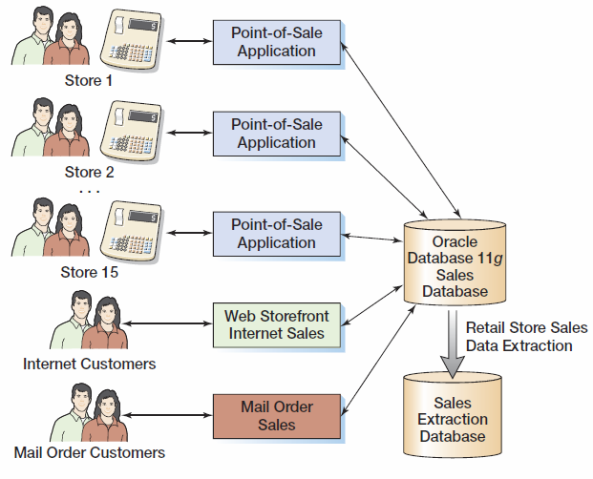
Cape Codd Retail Sales Structure

Slide 10
Cape Codd Outdoor Sports Retail Sales and Catalog Context Data Extraction I
The Cape Codd marketing department needs an analysis of:
In-store sales.
Catalog content.
The entire database is not needed for this, only an extraction of retail sales data and catalog content.
The data is extracted by the IS department from the operational database into a separate, off-line database for use by the marketing department.

Slide 11
Cape Codd Outdoor Sports Retail Sales and Catalog Context Data Extraction II
Five tables are used: RETAIL_ORDER, ORDER_ITEM, SKU_DATA (SKU = Stock Keeping Unit), CATALOG_SKU_2014, and CATALOG_SKU_2014
The extracted data is converted as necessary:
Into a different DBMS—Microsoft SQL Server
Into different columns—OrderDate becomes OrderMonth and OrderYear.

Slide 12
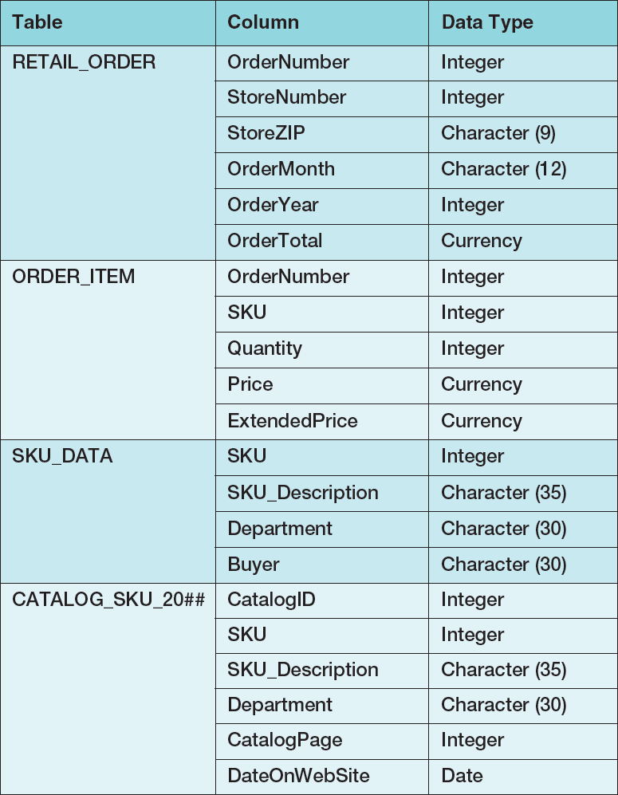
Extracted Data Format

Slide 13
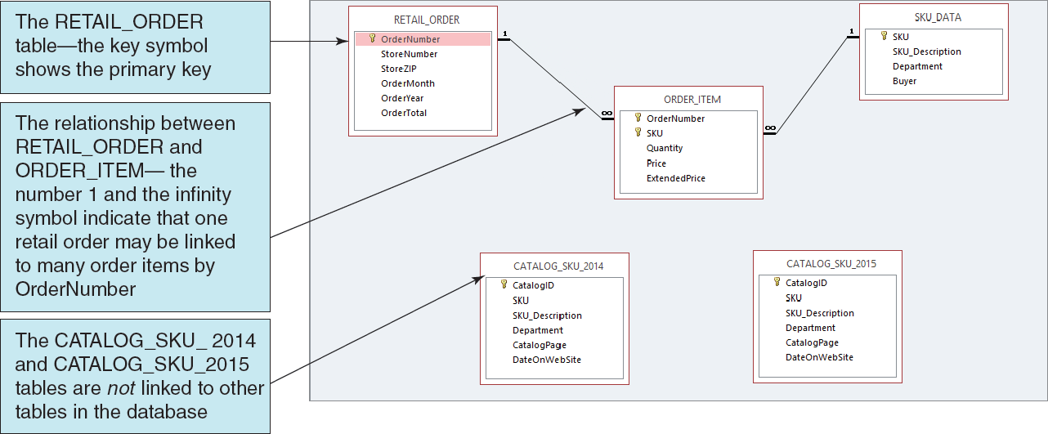
Extracted Data Tables I [in Microsoft Access 2013]

Slide 14
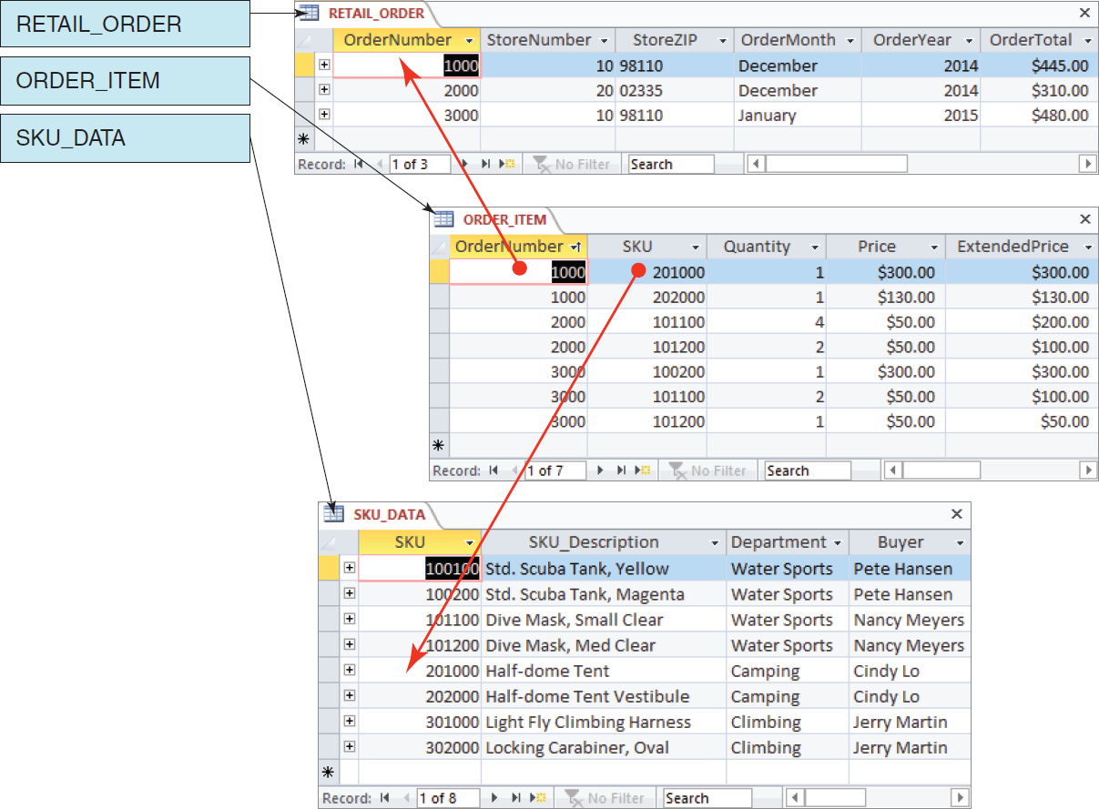
Extracted Tables II [in Microsoft Access 2013]

Slide 15
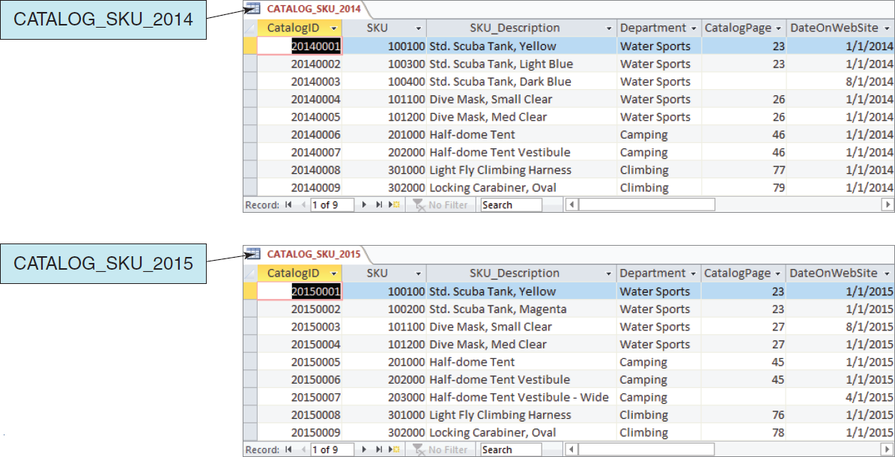
Extracted Tables III [in Microsoft Access 2013]

Slide 16
Cape Codd Database Available Online I
Versions of the complete Cape Codd database are available in the downloadable Student Files available at:
http://www.pearsonhighered.com/kroenke/
These include versions for:
Microsoft Access 2013
Microsoft SQL Server 2014
Oracle Database 12c and Oracle Database XE
MySQL 5.6
We recommend you actually run all material in a live database!

Slide 17
Cape Codd Database Available Online II
To complete setting up the Cape Codd database, set the referenced materials:
For Microsoft Access 2013:
The database *.accdb is ready for immediate use
For Microsoft SQL Server 2014:
See Online Chapter 10A
For Oracle Database 12c and Oracle Database XE:
See Online Chapter 10B
For MySQL 5.6L
See Online Chapter 10C
Online chapters 10A, 10B, and 10C are available for download at:
http://www.pearsonhighered.com/kroenke/

Slide 18
Querying Two or More Tables with SQL
SQL provides two different techniques for querying data from multiple tables:
■ The SQL subquery
■ The SQL join

Slide 19
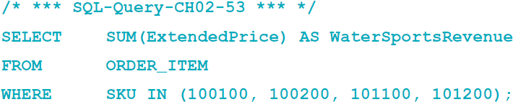
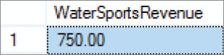
Querying Multiple Tables with SQL Subqueries The Logic of Subqueries I
We want to know the revenue for Water Sports items, which have SKU values of 100100, 100200, 101100, and 101200.
Given that we know the SKU values, we can use this query:

Slide 20
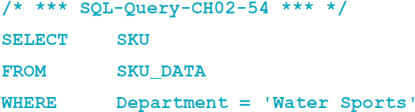
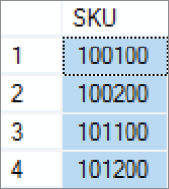
Querying Multiple Tables with SQL Subqueries The Logic of Subqueries II
What if we don’t know the SKU values? We can determine them with this query:

Slide 21
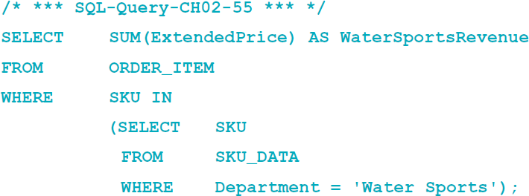
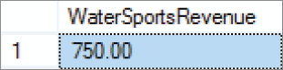
Querying Multiple Tables with SQL Subqueries The Logic of Subqueries III
We can combine these two as shown in SQL-Query-02-55. The second query, which is enclosed in parentheses, is call an SQL subquery. Note how the subquery returns a set of values for use by the top level query, and note the use of the SQL IN keyword.

Slide 22
Querying Multiple Tables with SQL Subqueries The Logic of Subqueries IV
An SQL subquery is often described as:
a nested query
A query within a query
Note that SQL queries using subqueries are still effectively single table queries in the sense that only the columns of the top level query can be displayed in the query results!
Multiple subqueries can be used to process three or even more tables.
All parts if the SQL SELECT statement syntax can be applied to the table displaying the results of an SQL query using subqueries.

Slide 23
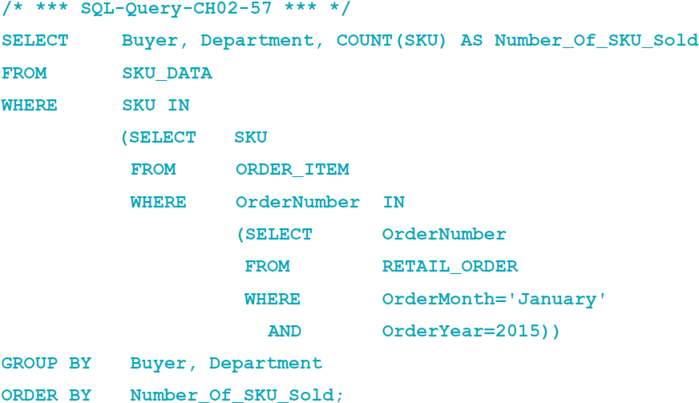
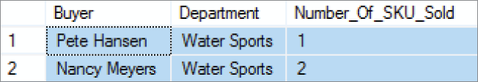
Querying Multiple Tables with SQL Subqueries The Logic of Subqueries V

Slide 24
Querying Multiple Tables with SQL Joins The Logic of Joins I
In an SQL join operation, the SQL JOIN operator is used to combine parts or all of two or more tables.
Explicit join ─ the SQL JOIN operator is used as part of the SQL statement.
Implicit join ─ the SQL JOIN operator is not used as part of the SQL statement.

Slide 25
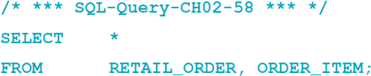
Querying Multiple Tables with SQL Joins The Logic of Joins II – SQL CROSS JOIN
In an SQL CROSS JOIN combines each row in one table with every row in another table.
This is known mathematically as a Cartesian product of the rows in the tables.
This is illogical in database work because we only need rows that somehow logically correspond in the two tables.

Slide 26
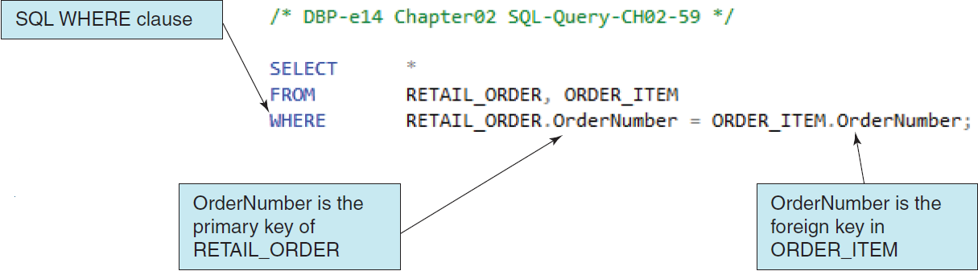
Querying Multiple Tables with SQL Joins The Logic of Joins III – Implicit SQL INNER JOIN
By selecting rows by matching by the primary key values of one table with the foreign key values of a second table, we produce an SQL INNER JOIN.
Because the SQL JOIN keyword does not appear in the SQL statement, this is an implicit join.

Slide 27
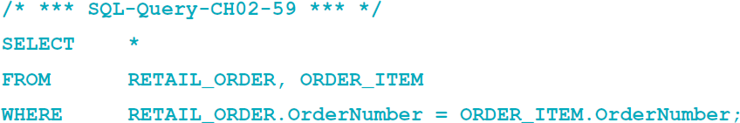
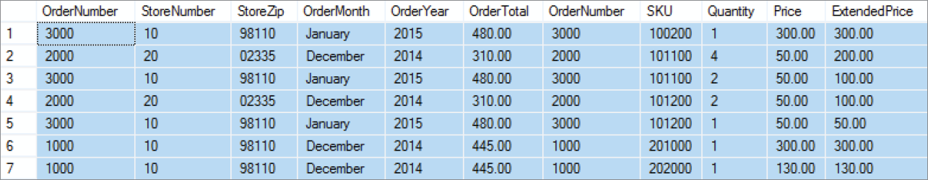
Querying Multiple Tables with SQL Joins The Logic of Joins IV – Implicit SQL INNER JOIN

Slide 28
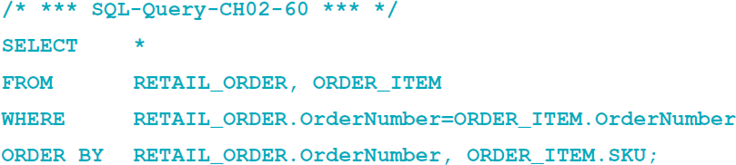
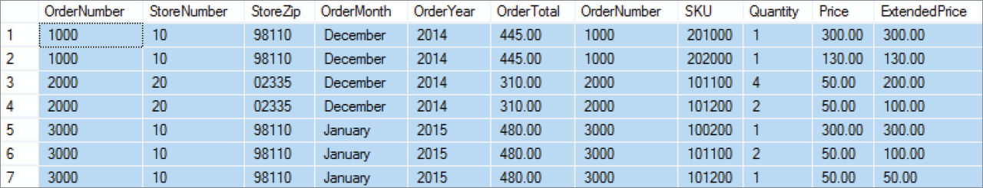
Querying Multiple Tables with SQL Joins The Logic of Joins V – Implicit SQL INNER JOIN
With an SQL ORDER BY clause for easier reading by OrderNumber:

Slide 29
Querying Multiple Tables with SQL Joins The Logic of Joins VI – EQUIJOIN
The process of using an SQL JOIN operation to join two tables is called joining the two tables.
When tables are joined using an equal to condition as in the example above, the join is called an equijoin.
When people say “join”, 99.99999 percent of the time they mean equijoin.
Multiple joins can be used to process three or even more tables.
All parts if the SQL SELECT statement syntax can be applied to the table displaying the results of an SQL query using joins.

Slide 30
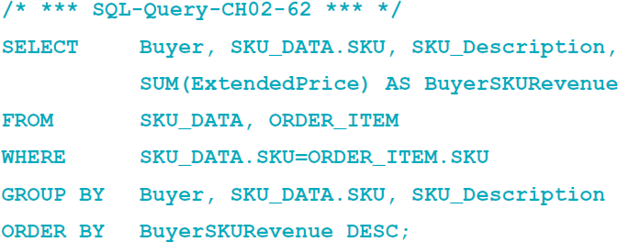
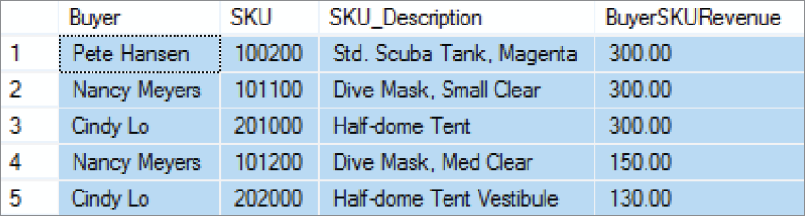
Querying Multiple Tables with SQL Joins The Logic of Joins VII

Slide 31
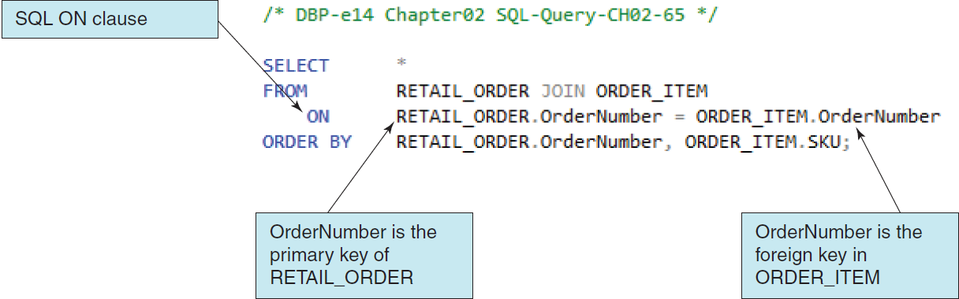
Querying Multiple Tables with SQL Joins The Logic of Joins VIII – Explicit SQL INNER JOIN
By selecting rows by matching by the primary key values of one table with the foreign key values of a second table, we produce an SQL INNER JOIN.
Because the SQL JOIN keyword does appear in the SQL statement, this is an explicit join.

Slide 32
Querying Multiple Tables with SQL Joins The Logic of Joins IX – SQL JOIN ON Syntax
In SQL JOIN ON syntax:
The SQL JOIN keyword is placed between the table names in the SQL FROM clause, where it replaces the comma that previously separated the two table names, and
The SQL ON keyword now leads into an SQL ON clause, which includes the statement of matching key values that was previously in an SQL WHERE clause.
The SQL WHERE clause is no longer used as part of the join, which makes it easier to read the actual restrictions on the rows in the query in the SQL WHERE clause itself.
The explicit SQL JOIN ON syntax is currently considered as the proper way to write SQL join operations, and the older implicit SQL syntax is considered an archaic, older syntax (but it still works).

Slide 33
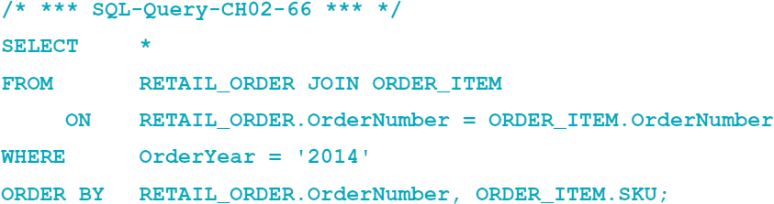
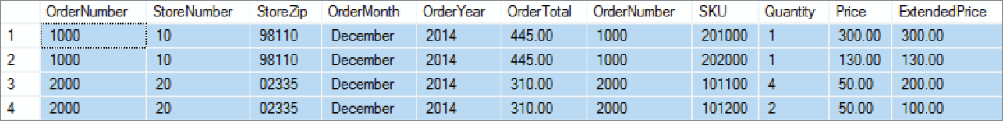
Querying Multiple Tables with SQL Joins The Logic of Joins X – SQL JOIN ON Syntax

Slide 34
SQL Subqueries versus SQL Joins
SQL subqueries and SQL joins both process multiple tables.
An SQL subquery can only be used to retrieve data from the “top table”.
An SQL join can be used to obtain data from any number of tables, including the “top table” of the subquery.
In Chapter 8, we will study the correlated subquery. That kind of subquery can do work that is not possible with joins.

Slide 35
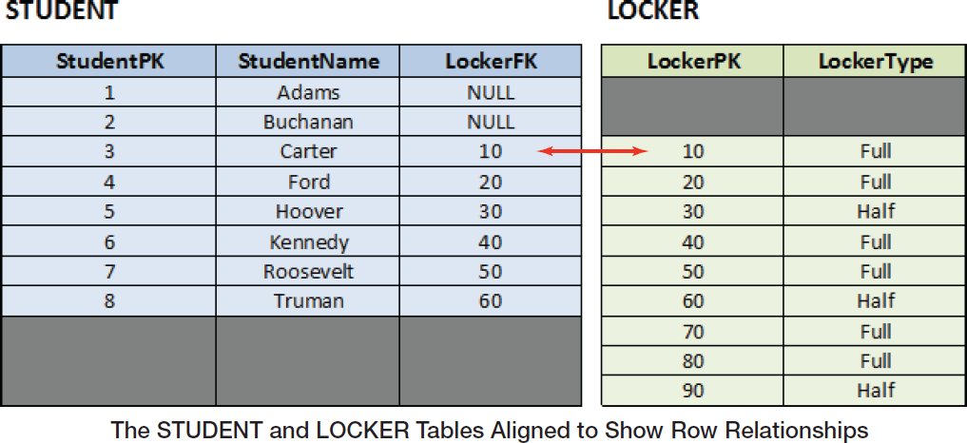
Querying Multiple Tables with SQL Outer Joins The Logic of Outer Joins I – Example Tables

Slide 36
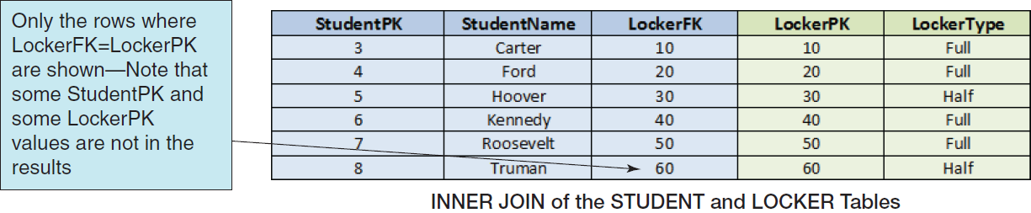
Querying Multiple Tables with SQL Outer Joins The Logic of Outer Joins II – SQL INNER JOIN

Slide 37
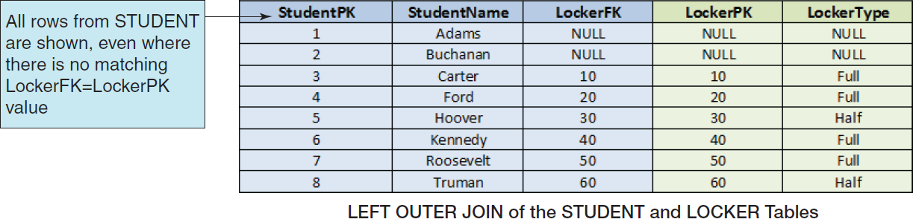
Querying Multiple Tables with SQL Outer Joins The Logic of Outer Joins III – SQL LEFT OUTER JOIN

Slide 38
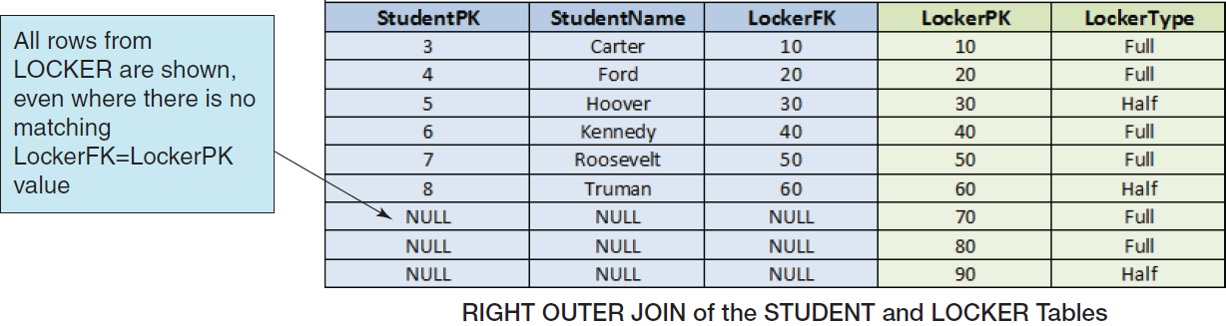
Querying Multiple Tables with SQL Outer Joins The Logic of Outer Joins IV – SQL RIGHT OUTER JOIN

Slide 39
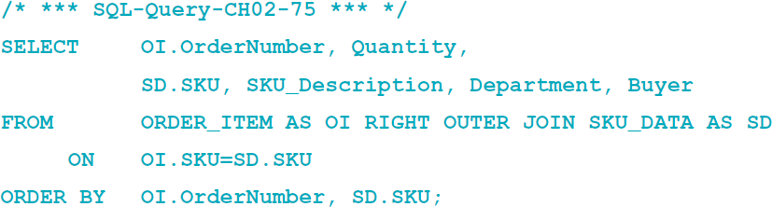
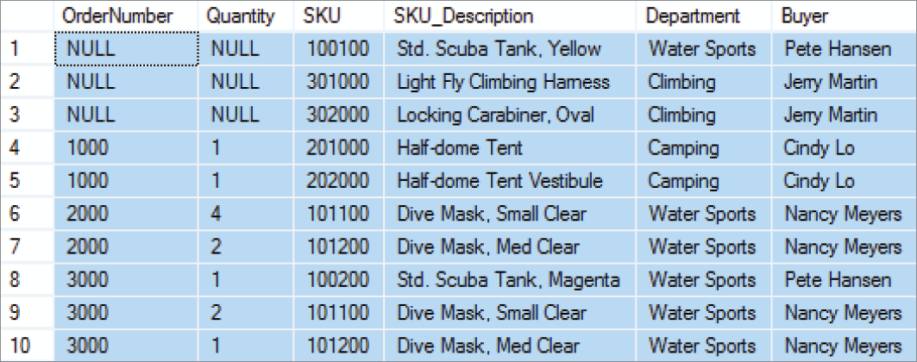
Querying Multiple Tables with SQL Outer Joins The Logic of Outer Joins V – SQL OUTER JOIN Syntax
Note the use of the SQL syntax RIGHT OUTER JOIN … ON in the query, and note the NULL values in the query results:

Slide 40
Querying Multiple Tables with SQL Set Operators The Logic of Set Operators I – Mathematical Set Theory
Mathematicians use the term set theory to describe mathematical operations on sets, where a set is defined as a group of distinct items.
A relational database table meets the definition of a set, so it is little wonder that SQL includes a group of set operators for use with SQL queries.

Slide 41
Querying Multiple Tables with SQL Set Operators The Logic of Set Operators II – Venn Diagrams
Venn diagrams are the standard method of visualizing sets and their relationships.
A set is represented by a labeled circle.
A subset is a portion of a set that is contained entirely within the set.
The union of two sets represents a set that contains all values in both sets. This is equivalent to an OR logical operation (A OR B).
The intersection of two sets represents the area common to both sets. This is equivalent to an AND logical operation (A AND B).
The complement of set B in set A represents everything in set A that is not in set B. This is equivalent to a logical operation using NOT (A NOT B).

Slide 42
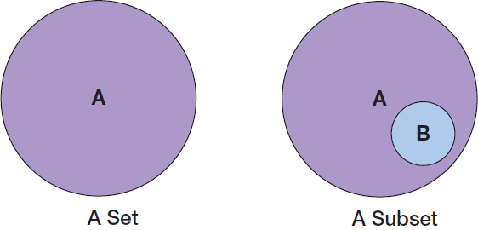
Querying Multiple Tables with SQL Set Operators The Logic of Set Operators III – Venn Diagrams – Set and Subset

Slide 43
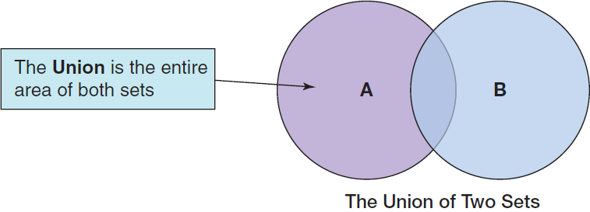
Querying Multiple Tables with SQL Set Operators The Logic of Set Operators IV – Venn Diagrams – Union

Slide 44
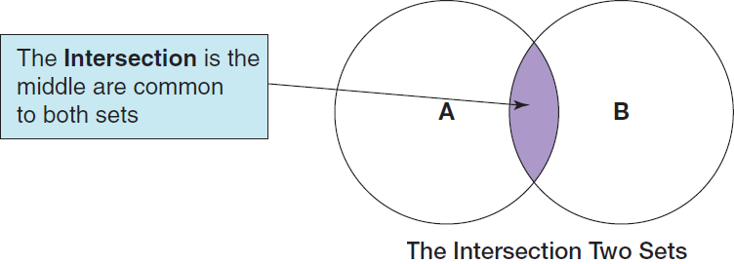
Querying Multiple Tables with SQL Set Operators The Logic of Set Operators V – Venn Diagrams – Intersection

Slide 45
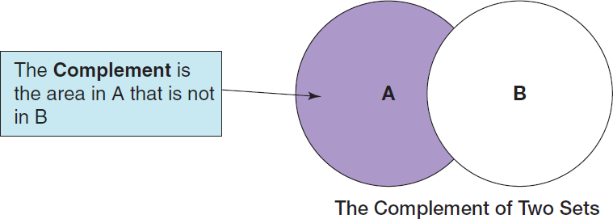
Querying Multiple Tables with SQL Set Operators The Logic of Set Operators VI – Venn Diagrams – Complement

Slide 46
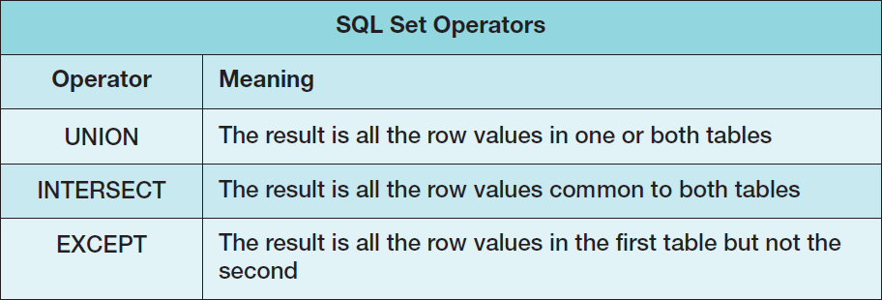
Querying Multiple Tables with SQL Set Operators The Logic of Set Operators VII – SQL Set Operators
Note that in order to use SQL set operators, the table columns involved in the operations must be the same number in each SELECT component, and corresponding columns must have the same or compatible (e.g., CHAR and VARCHAR) data types!

Slide 47
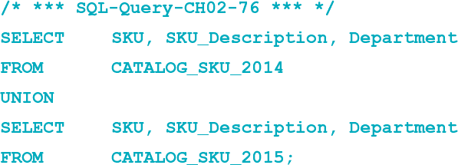
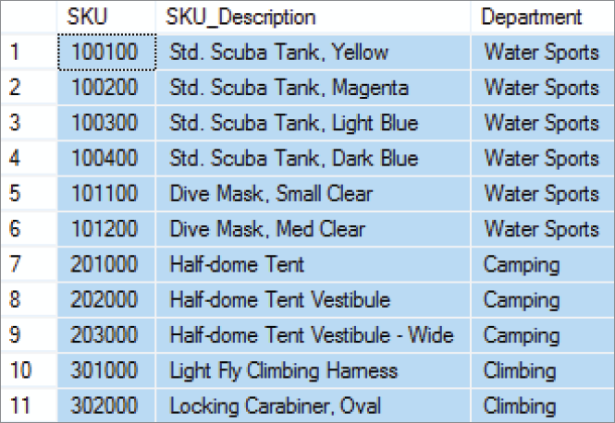
Querying Multiple Tables with SQL Set Operators The Logic of Set Operators VIII – SQL UNION Operator
“What products were available for sale (by either catalog or Web site) in 2014 and 2015?”

Slide 48
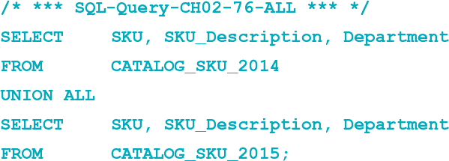
Querying Multiple Tables with SQL Set Operators The Logic of Set Operators IX – SQL ALL Keyword
If we compare the output of SQL-Query-CH02-76 to the data in the CATALOG-SKU_2014 and CATALOG_SKU_2015 tables, we will note that there are no duplicate rows in the query output. For example, SKU 201000, the Half-Dome Tent, is in each table, but only appears once in the query output. If, for some reason, we want the duplicated rows to be displayed in the query output as well, we would simply add the SQL ALL keyword to the query:

Slide 49
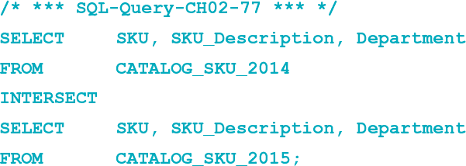
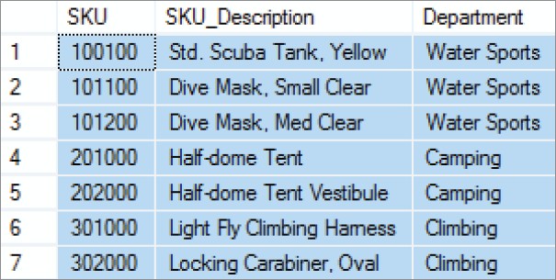
Querying Multiple Tables with SQL Set Operators The Logic of Set Operators X – SQL INTERSECT Operator
“What products were available for sale (by either catalog or Web site) in both 2014 and 2015?” [MySQL 5.6 does not support the INTERSECT Operator]

Slide 50
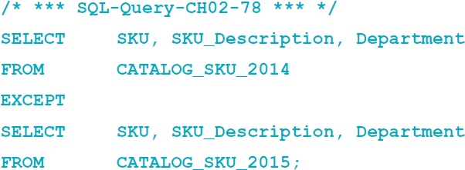
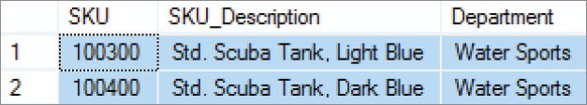
Querying Multiple Tables with SQL Set Operators The Logic of Set Operators XI – SQL EXCEPT Operator
“What products were available for sale (by either catalog or Web site) in 2014 but not in 2015?” [Oracle Database calls this the SQL MINUS operator, and MySQL 5.6 does not support this operation]

Slide 51
David Kroenke and David Auer Database Processing Fundamentals, Design, and Implementation (14th Edition)
End of Presentation:
Chapter Two Part Two

Slide 52

All rights reserved. No part of this publication may be reproduced, stored in a retrieval system, or transmitted, in any form or by any means, electronic, mechanical, photocopying, recording, or otherwise, without the prior written permission of the publisher. Printed in the United States of America.

